Slide 1


Data Engineering
By Jimmy Chung

Slide 2


DELIVERABLE ALIGNMENT
Notebook
Presentation
Implementation
Technical documentation of Snowpark Python and SQL data pipeline.
Evidence of Execution
Features production code in a live execution environment with outputs.
Data Profiling & Visual Aid
Showcases a visual representation of change in data during the cleaning process.
Justification
Contains markdown and comments for interpretability of engineering choices.
Stakeholder Delivery
Documentation curated for non-technical stakeholders to assess the delivery.
Problem Statement
The planning process; identifying the requirements of the assigned task.
Methodology Overview
Step-by-step summary highlighting key processes involved with the technical implementation.
Reflection
Self-evaluation of the assignment and future considerations.

Slide 3
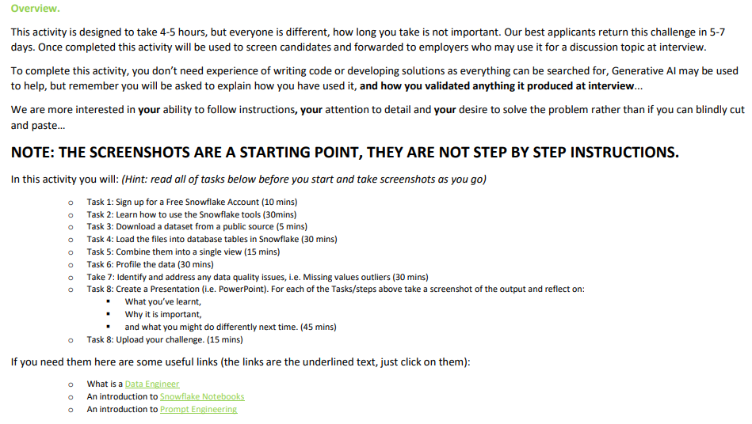
UNDERSTANDING THE TASK
The task brief, annotated with the key insights and requirements drawn from it
Look beyond the scope — granular depth signals higher-quality work.
AI is allowed with clear justification — do not depend on it.
1
1
5
2
5
Low difficulty overall, though programming and technology experience helps.
6
Clear ownership of the work must be evident throughout.
2
6
B
Single view integration across multiple datasets — not a modelling exercise.
A
Delivered as a presentation, testing written communication.
3
3
7
4
7
Cleaning the datasets is where the bulk of the delivery lies.
8
Self-reflection included; may assess capacity to learn.
4
8
Dataset Source: https://github.com/whythedots/DataEngineerCars
A
Expected Tools: Snowflake / PowerPoint
B

Slide 4


AIMS & OBJECTIVES
1.
Utilise Snowflake to integrate data from multiple sources into a single view.
2.
Perform data cleansing on the produced view ensuring that the data is reliable.
Develop a clean unified data view and fully documented integration workflow within 14-days.
3.
Produce a presentation summarising the workflow with evidence.
4.
Include a self-reflection section within the presentation.

Slide 5
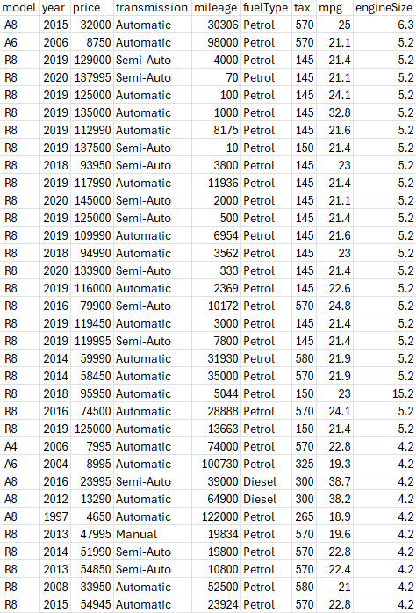
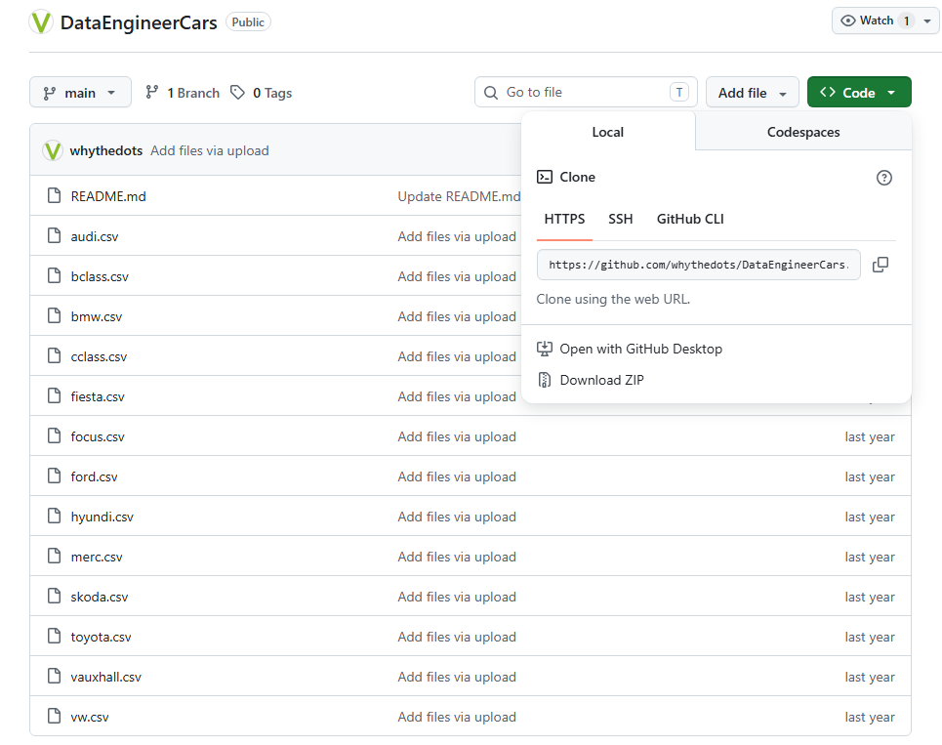
THE DATA
View the Data in Excel
Contents
Provides insight into table structures of the datasets.
Familiarise the contents for context.
Spot inconsistencies within the data.
Identify any transformation needs.
Preparing a plan for cleaning the data.
Topic: Car datasets.
Total datasets: 13
Source: GitHub
Before loading the data into Snowflake.
The following were renamed for readability:
merc.csv → mercedes.csv
vw.csv → volkswagen.csv

Slide 6
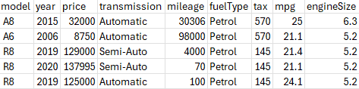
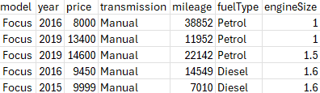
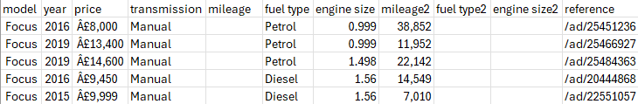
THE DATA
9 columns
Includes | audi.csv, bmw.csv, ford.csv, hyundi.csv, mercedes.csv, skoda.csv, toyota.csv, vauxhall.csv, volkswagen.csv.
Inspecting the Data in Excel
A
audi.csv sample.
Identified three types of table structure.
7 columns
Includes | cclass.csv, focus.csv.
Type C follows a similar structure to Type A, but with two less columns.
However, Type B will require special attention due to a different structure.
C
focus.csv sample.
11 columns
Includes | bclass.csv, fiesta.csv.
B
fiesta.csv sample.

Slide 7




THE DATA
Data Reconciliation
Redundancy
Inconsistency
Pipeline Errors
Outliers
Duplicates
Empty rows
Redundant fields
EngineSize2
FuelType2
Mileage2
Placeholders
‘N/A’
Type mismatch
Unit mismatch
Litres vs CC
Stray characters
Leading currency.
Whitespace padding
Floating point noise
Rounding trails
Data misalignment
Shifted columns
Value errors
Overflow
Corrupt data
Encoding
Unknown values
Mathematical outliers
Extreme values
Calculation errors
Out of range data
Date in the future
Negative price
Typos
Spelling
Trailing/leading numbers

Slide 8




LOADING INTO SNOWFLAKE
User Interface
Chosen Method
Using the ‘Load Data into Table’ GUI to drag and drop datasets into the database to generate tables.
Programmatically
Quick & easy to use, zero coding.
Why?
Lack of control over schema and tables, no audit trail.
Data Quality Management
Mitigating risk from incorrectly generated tables such as data types.
Robust Workflow
Leaves a record of reusable code involved with production.
Self-Development
Learning SQL is beneficial for my professional development.
Programmatically
Hard coding to define and build tables and schemas before importing data into the database.
Customisability, audit records, automatable.
Time-consuming to code, requires coding knowledge.

Slide 9
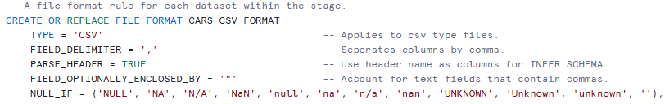
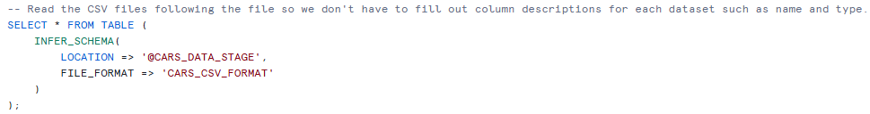


LOADING INTO SNOWFLAKE
Stage
Holds the raw source files
Sample_code.ipynb
1
2
File Format
Defines CSV parsing rules.
3
Infer Schema
Detects columns and types.
4
Create Tables
Builds tables from the inferred schema.
5
Populate
Copies data into the tables

Slide 10
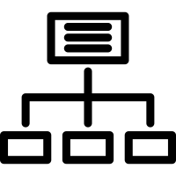

DATABASE STRUCTURE
CARS_DATA
Databases
MASTER
CARS_DATA
The main workspace containing all raw and process data.
CARS_DATA_BACKUP
A safe copy of the database as contingency for rollback.
CLEANED_CARS_DATA
PUBLIC
Schemas
MASTER
Holds the final cleaned data ready for use.
PUBLIC
Mixing zone where datasets are combined into a single view.
TYPE_A - C
Categories to group data by their table structure.
STAGE
TYPE_A
AUDI
Tables
BMW
CLEANED_CARS_DATA
Final version of the dataset after merging and cleaning.
CARS
Raw datasets loaded from their source files.

Slide 11

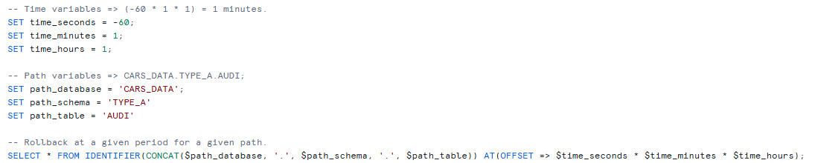

VERSION CONTROL
Database Clone
Keeping a master copy of the original database as a safety net for rollback in extreme circumstances.
Implementation
Version control provides a safe environment to make changes to files, allowing for alterations to be tracked and reverted if necessary.
After loading the data into Snowflake, a copy of the database was made which can be used to revert to the original database if necessary.
Time travel is another form of version control, unique to Snowflake which can help revert minor changes.
Time Travel
A Snowflake rollback feature that allows for changes to be reverted up to 24-hours by specifying the timeframe or period.

Slide 12
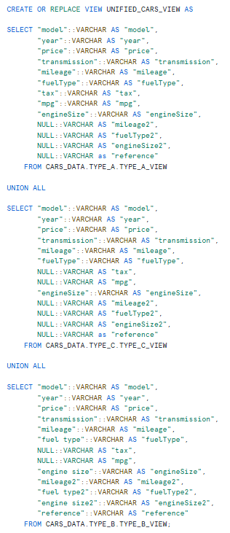
UNIFIED VIEW
AUDI
Merging Views
BMW
TYPE VIEWs
Datasets of the same table structure were merged into views first for interpretability.
Unified View
Due to conflicting data types, all columns were casted as VARCHAR.
Columns
13 total columns.
Column Headers
camelCase was used for consistency, with ‘duplicate’ columns having a trailing 2. e.g. ‘engineSize2’.
FORD
HYUNDI
MERCEDES
TYPE_A_VIEW
SKODA
TOYOTA
VAUXHALL
VOLKSWAGEN
BCLASS
TYPE_B_VIEW
FIESTA
CCLASS
TYPE_C_VIEW
UNIFIED_CARS_VIEW
FOCUS

Slide 13
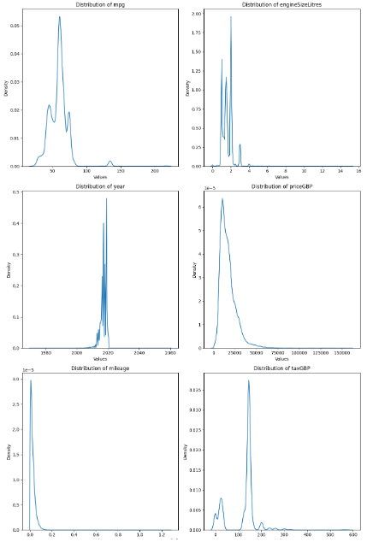
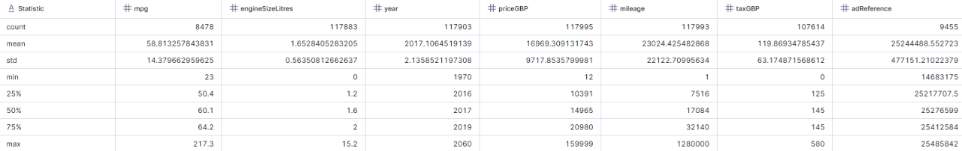
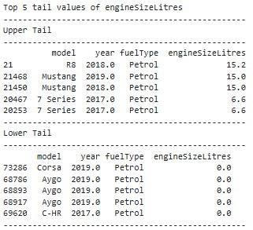
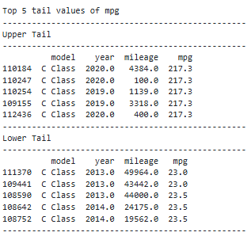
DATA PROFILING
Distribution
Summary Statistics
Extreme Values

Slide 14
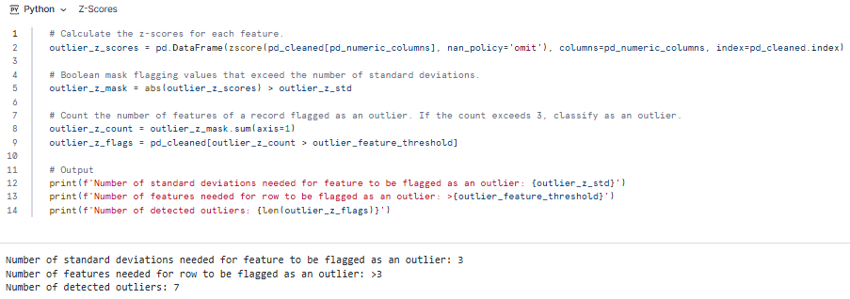
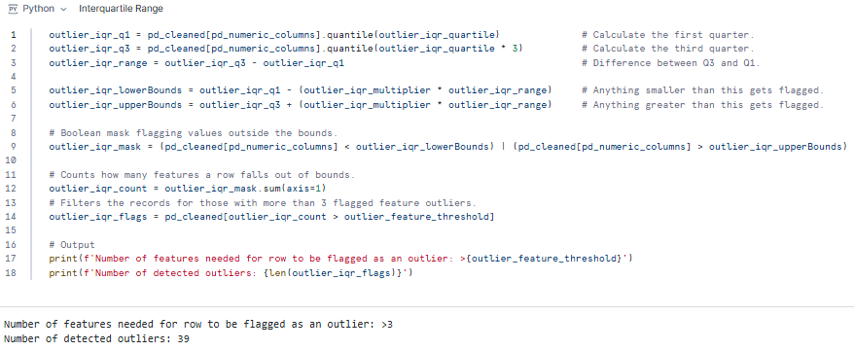
DATA PROFILING: OUTLIERS
Z-Scores
Methodology
Data profiling is used to summarise and examine data to assess its overall quality for given study. Due to VARCHAR typing and data misalignment, most of the data profiling occurred after some initial data cleansing.
Summary Stats
Generates a statistical breakdown of quantitative fields.
Distribution
Visualising the shape of the data using a KDE to identify any unusual patterns such as long tails.
Extreme Values
Listing out the maximum and minimum values present within a field to determine any exceptional values.
Outliers
Identifying abnormal values using mathematical measurements. Z-Score and IQR were used. See notebook for explanation.
Key Findings
Incorrect data typing.
Misaligned data.
Inconsistent measurements.
Stray characters.
Out-of-range values.
Flagged outliers.
Interquartile Range

Slide 15



CLEANSING
Structure
Strings
Numeric
Deduplication
Eliminating unintentional reoccurring rows. 2272 flagged duplicates that were retained due to insufficient evidence to remove them.
Empty Rows
Dropping rows that contain no data.
Column Headers
Applying consistent formatting rules such as casing and measurement for clear and efficient querying.
Stray Characters
Removing redundant characters that affect querying or calculations such as commas, currency signs, or units of measurement.
Trim
Shaving off any leading and / or trailing spaces that may affect querying or calculation logic.
Type Casting
Converting VARCHAR columns into their correct numeric type such as integer or floats to enable calculation features.
Rounding
Minimising redundant floating point noise.
Rescaling Metrics
Recalculating numeric values based on their units of measurement, such as dividing by 1000 for CC to Litres.

Slide 16
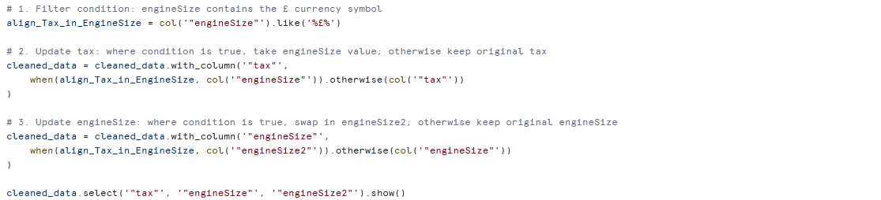
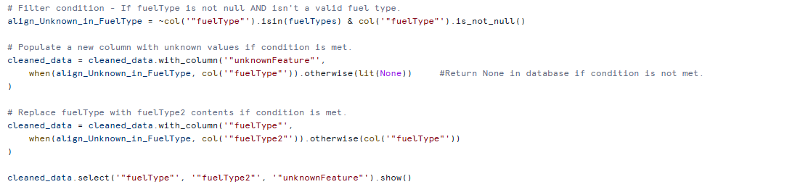
CLEANSING: MISALIGNMENT
tax
engineSize
engineSize2
mileage
mileage2
mpg
fuelType
fuelType2
unknown
engineSize
mileage
fuelType
tax
mpg
unknown
Methodology
Sample_code.ipynb
TYPE_B contains duplicate columns for ‘engineSize’, ‘mileage’, and ‘fuelType’. Within these duplicate columns contains values belonging to different columns. These are misaligned data.
For example:
‘engineSize2’ possesses ‘tax’, ‘engineSize’, and NULL values.
These misaligned data point shows signs of patterns.
For example:
Where row in ‘engineSize’ is NULL, ‘engineSize2’ has ‘engineSize’.
These patterns can be used to create conditions to copy the data from the duplicate column, to the intended column.
The ‘unknownFeature’ column was created to accommodate values that do not belong to any known column.

Slide 17




CLEANSING: UNKNOWNS
Missing
Typos
01
03
Values that were left blank or assigned NULL to symbolise an absent value within the column.
Missing values were retained as NULL to maintain data integrity and prevent any calculation bias.
Unknown values caused by misplaced characters. They’re not systematic so they can be difficult to detect
Used the following methods:
Reviewing distinct string categories.
Sorting unique numeric values.
‘engineSize’ had three numeric typos.
Handling
Unless the correct value is known, most unknown values are casted to NULL to avoid affecting column logic.
Placeholder
Anomalies
02
04
Arbitrary values assigned to represent unknown values. Typical examples include:
N/A, Unknown, NaN.
Most placeholder values were converted to NULL via CSV parsing rules. Exceptional examples such as 0.0 in engineSize for Petrol were handled on a case-by-case basis.
Values that do not meet the field’s logic, as a result are treated as invalid or incorrect values.
Often rare, therefore they’re handled on a case-by-case basis.
‘year’ had two anomalies, one being a future year, the other being too old.

Slide 18

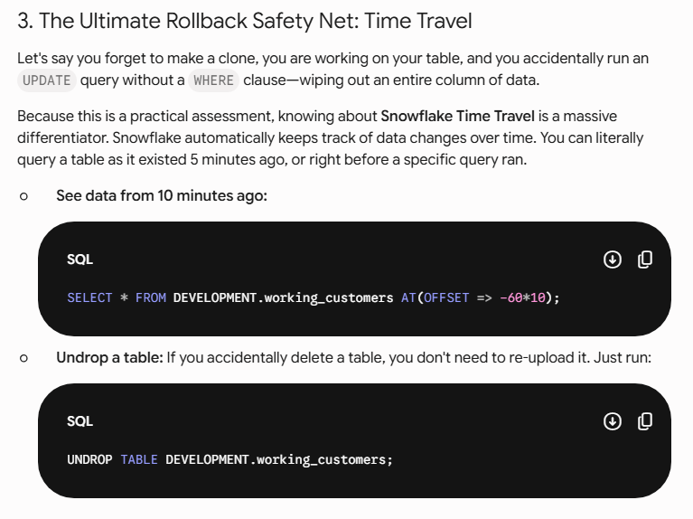

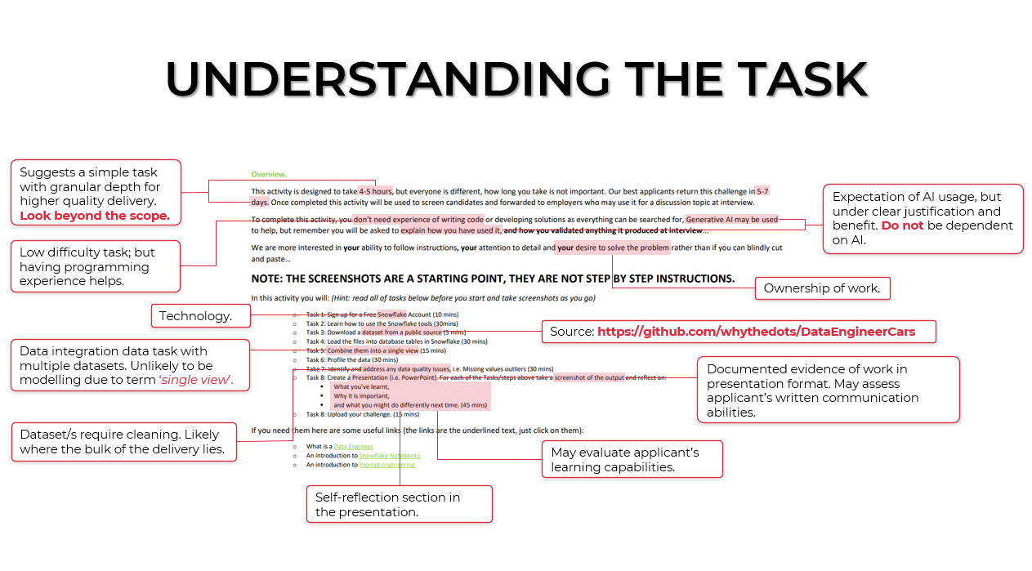
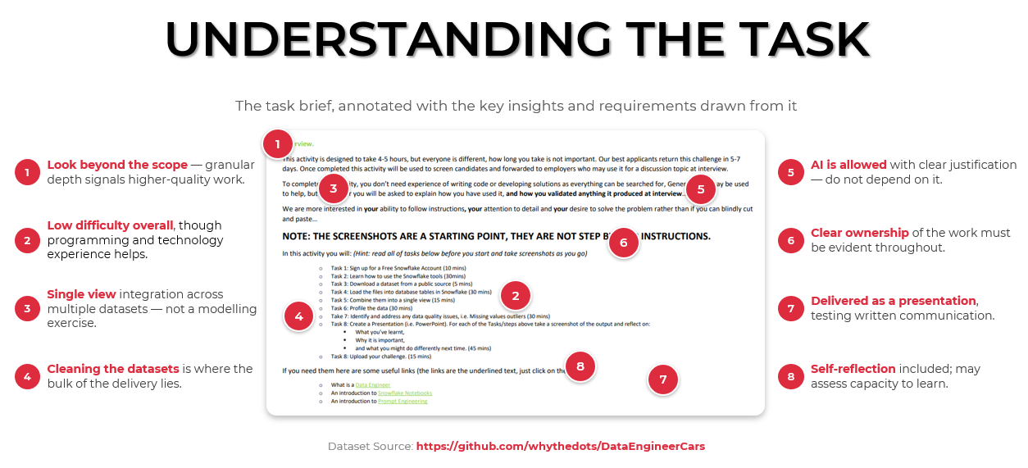
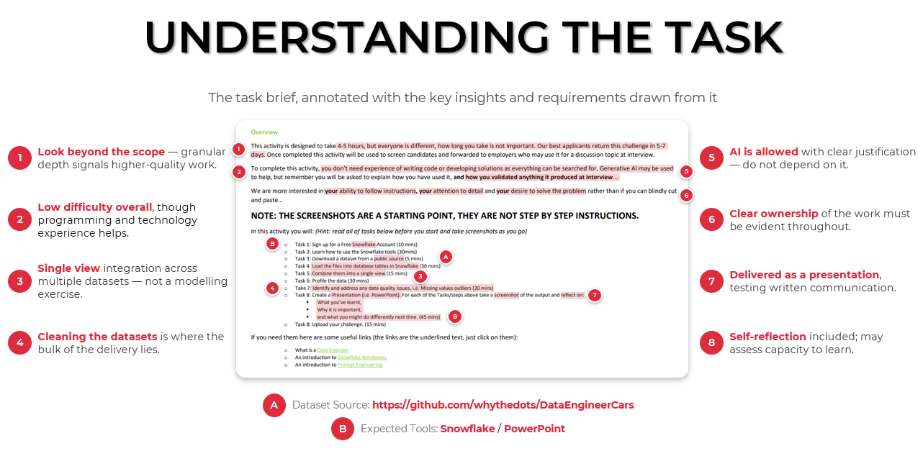

AI USAGE
Sample_code.ipynb
Cortex Code
CoCo’s code.
Used in Snowflake environment to assist with debugging and generating boiler plate code used to learn Snowflake specific SQL or Python syntax.
E.g. See Section 6.2: Align Tax & EngineSize.
My code based on CoCo’s implementation.
Gemini
Response when informing me about Snowflake’s Time Travel when proposing to create a master copy database.
Help with cross examining plans towards engineering workflows. Treated as an assistant who offers alternative suggestions when extra domain knowledge is insightful.
E.g. Informing me about Time Travel when discussing options for Snowflake version control.
Copilot
Assist with complex visual layout and design of select slides alongside asset generation.
E.g. Slide 3’s annotation layout, slide 8’s curved dotted lines, and slide 18’s split donut shapes.
Transforming to annotations w/ pins, to maintain consistent quality with other presentation slides.

Slide 19


THANK
YOU!
My presentation only contains an overview of what I’ve done and may not accurately reflect the technical implementation.
It’s recommended to look at Notebook.inpyb which documents most of the logic and decision making processes.
For any questions:
chungjvariance@gmail.com
www.linkedin.com/in/jimmy-chung-3bb430414

